Slide 1




Oracle Cloud Solution Hubs Data Integration with OAC
Steven Black
Mark Geurtsen
March 2018

Slide 2

POC
Data Integration and Analysis using BDC, OAC, OEH March 2018
Copyright © 2018, Oracle and/or its affiliates. All Rights Reserved. | Confidential – Oracle Internal
Notes:
.

Slide 3


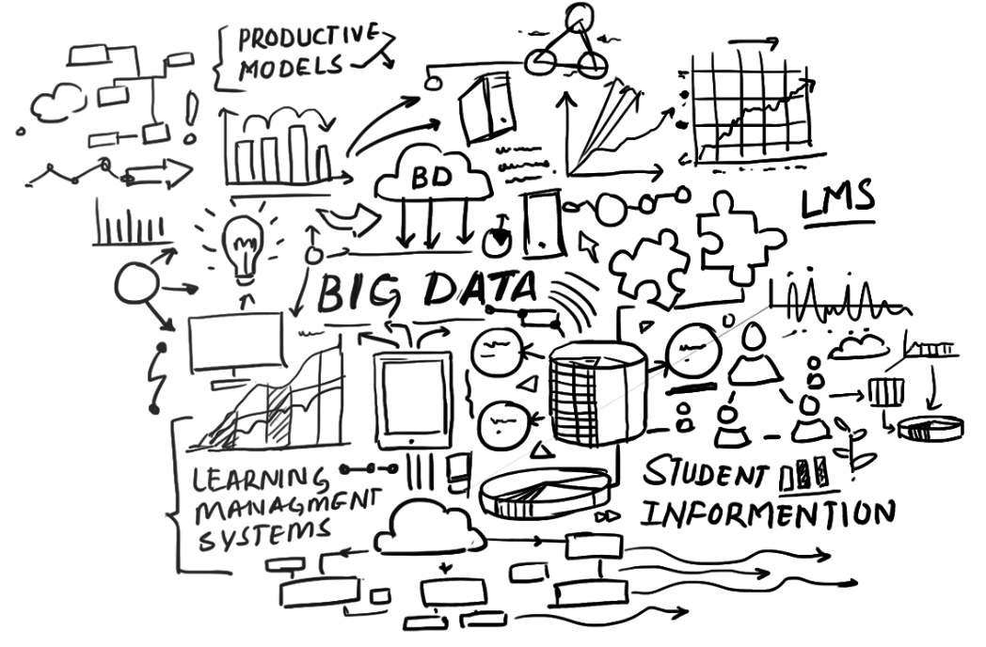









Solution Highlight
Solution Name with Technology
Go to the Solution Bank Asset Page
Go to the Asset Folder in ODocs
Watch the Solution Prototype Video
Avocado's Incorporated is a lifestyle branding company that sells avocados and other avocado based products.
Using Oracle Analytics Cloud and Oracle's Big Data Platform we manage to do datablending from different datasources and apply built-in Machine Learning capabilities to realtime Analytics.
This gives Avocado's Incorporated a better insight into their business, tracking marketing campaigns and keep innovating using the latest technology.
Lead ECA Name
Lead Developer Name
Cloud Developer Name
Cloud Developer Name
Copyright © 2018, Oracle and/or its affiliates. All Rights Reserved. | Confidential – Oracle Internal
Notes:
.

Slide 4
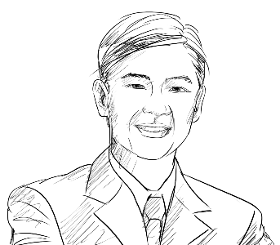




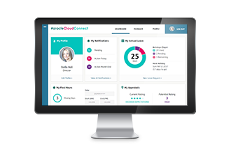




Notional Architecture
Realtime Analytics with Big Data
Twitter as a publisher in Kafka
Revenue from Oracle Fusion ERP Finance Cloud (demo content)
Roland
CIO
Event Hub Cloud
Lisa
Marketing Executive
Big Data as a Consumer of Kafka
Interaction
Default connection between Analytics and Big Data
Oracle Analytics
Cloud Service
Oracle Big Data Cloud
Marketing budgets stored in Excel, blended in Analytics
Analytics datasets stored in Database Cloud
Database
Cloud Service
Copyright © 2018, Oracle and/or its affiliates. All Rights Reserved. | Confidential – Oracle Internal
Notes:
.

Slide 5
Business Value
Solution Name
Insert Photo and Send to Back
Industry Disruption & Competitiveness
List
List
List
Revenue Impacts
Cost Impacts
List
List
List
List
List
List – include increases in development and cloud services budget or else the omission will stick out.
Copyright © 2018, Oracle and/or its affiliates. All Rights Reserved. | Confidential – Oracle Internal
Notes:
.

Slide 6
Internal Data Sheet
Fast Food Ordering Chatbot
Target Customers
Industries:
Customers:
Prototype Demo Story
Begins with
Then user does X, see Y.
Then user does XX, see YY.
Ends with
Oracle Cloud Services
Name CS (XCS)
Name CS (YCS)
Name CS (ZCS)
Developer Experience
Time to build POC:
Skills required:
How did Oracle technology help speed development, integration, or deployment?
What technical challenges did you face?
Primary Use Cases
<Use Case #1>
<Use Case #2 or Variations on Use Case #1>
Technology Solution
Special Integrations:
To Oracle Applications:
To Third Party S/W:
To Open Source:
Custom Coding:
Language/Describe
Team
Account Sales Team:
Name (KAD)
Name (CPR)
SE Team:
Name (ECA)
Name (Lead Developer)
Name (Cloud – XX Developer)
Name (CSM)
Others:
<from Product Dev>
Marketing Messages
Business Value:
How Differentiated/Innovative:
Why Oracle?:
Copyright © 2018, Oracle and/or its affiliates. All Rights Reserved. | Confidential – Oracle Internal
Notes:
.

Slide 7




For More Information
Our People
Our Hubs
Our Solutions
Our OTube Channel
http://solutionengineering.us.oracle.com/hubs
Copyright © 2018, Oracle and/or its affiliates. All Rights Reserved. | Confidential – Oracle Internal

